Slide 1

Big data analysis using hadoop and mapreduce
Project Mentor:
Dr. Pooja Tripathi
Project Members:
Ila Srivastava
Surbhi Singh
Shailaja Chaudhary
Swati Shukla

Slide 2
What is big data?
Today there are a number of organizations generating huge amount of data and according to statistics by IBM it has been estimated that more than 90 %of the data in the world today has been created in last two years alone.
“Big data is the term for a collection of data sets so large and complex that it becomes difficult to process using on-hand database management tools or traditional data processing applications.”
3 V’s-dimensions of BIG DATA
Volume refers to the size of data that you’re dealing with, Variety refers to the fact that the data is often coming from lots of different sources and in many different formats, and Velocity refers to the speed at which the data is being generated, and the speed at which it needs to be made available for processing.

Slide 3
Hadoop and mapreduce
Hadoop gives us a way to store data in distributed system known as Hadoop Distributed File System (HDFS) and a way to process data by a way called Map Reduce. Files are stored in the Hadoop Distributed File System. When a file is loaded into HDFS, it is split into chunks, which are called blocks. Each block is pretty big; the default is 64 megabytes and each block will be stored on one node in the cluster.
MapReduce-Processing large files of data serially from the top to the bottom takes a long time. So, Mapreduce is designed to parallelly process data, such that the data is split into many pieces, and each piece is processed simultaneously.

Slide 4
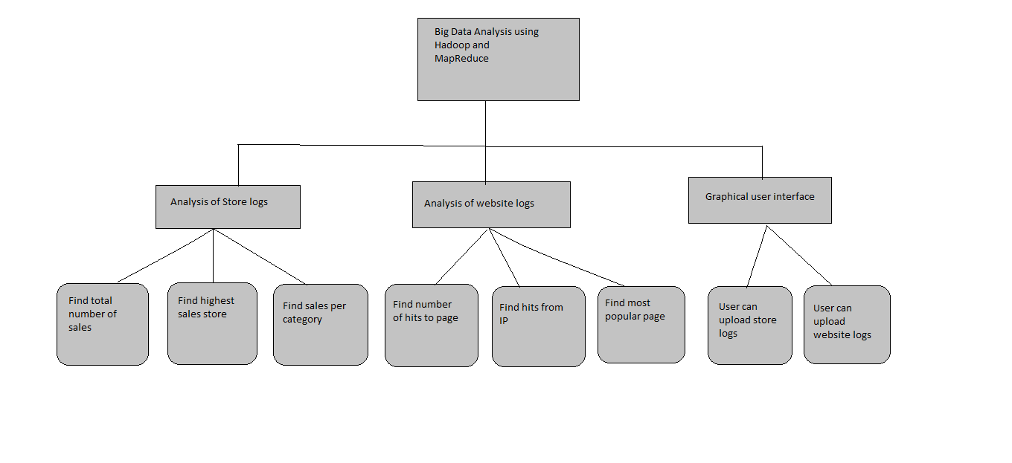
MODULES

Slide 5
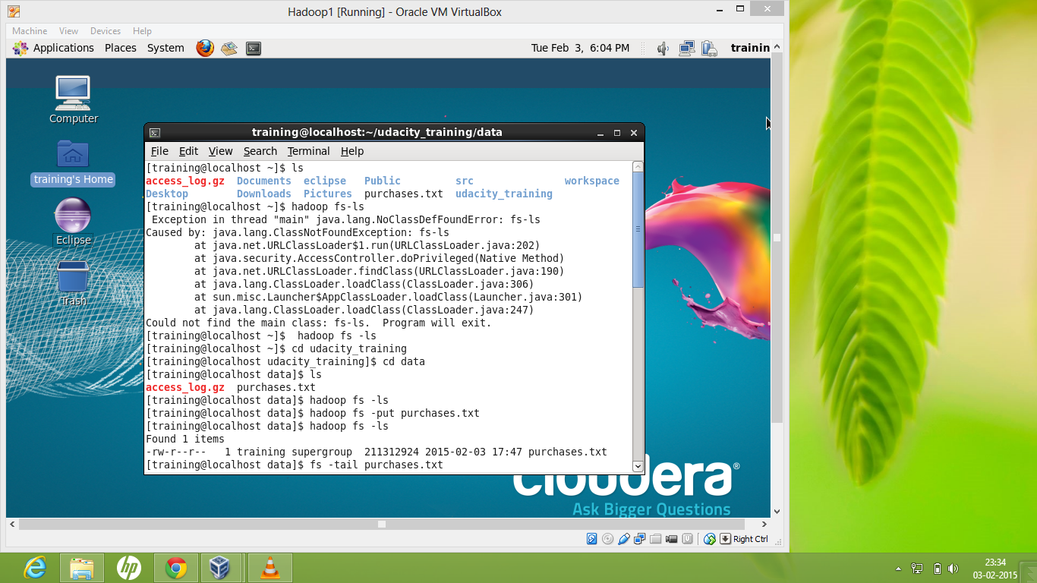

Slide 6
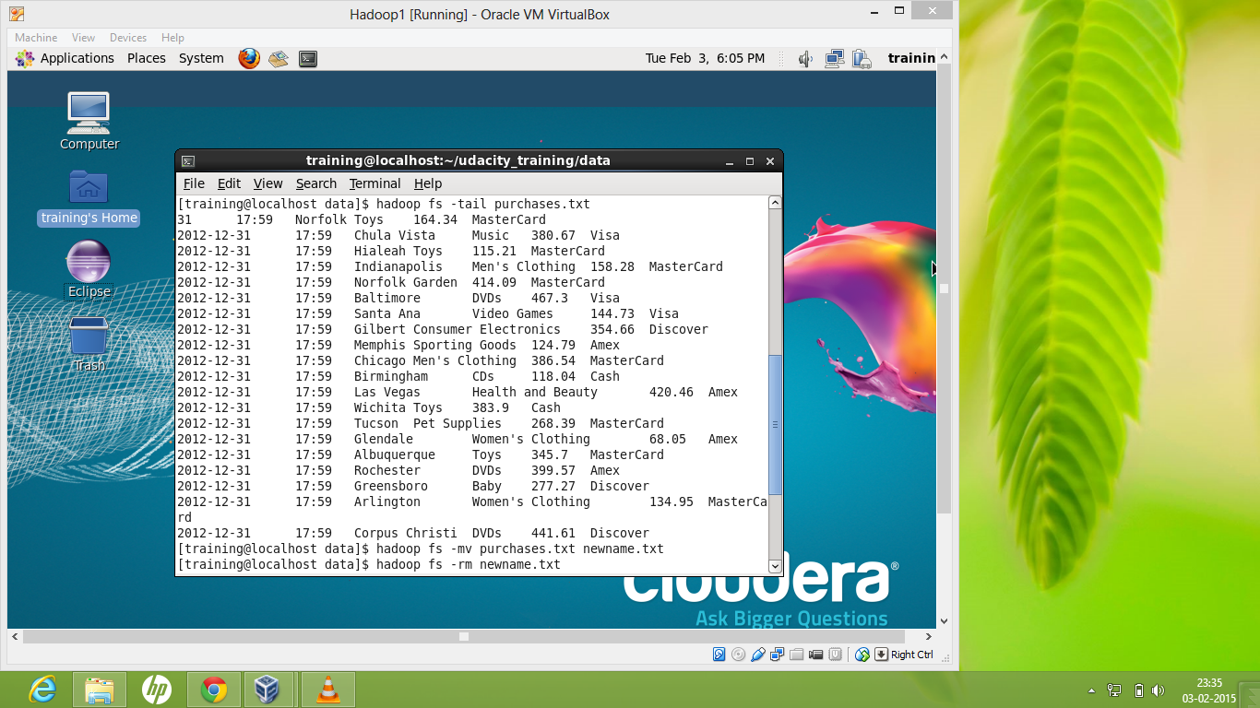

Slide 7
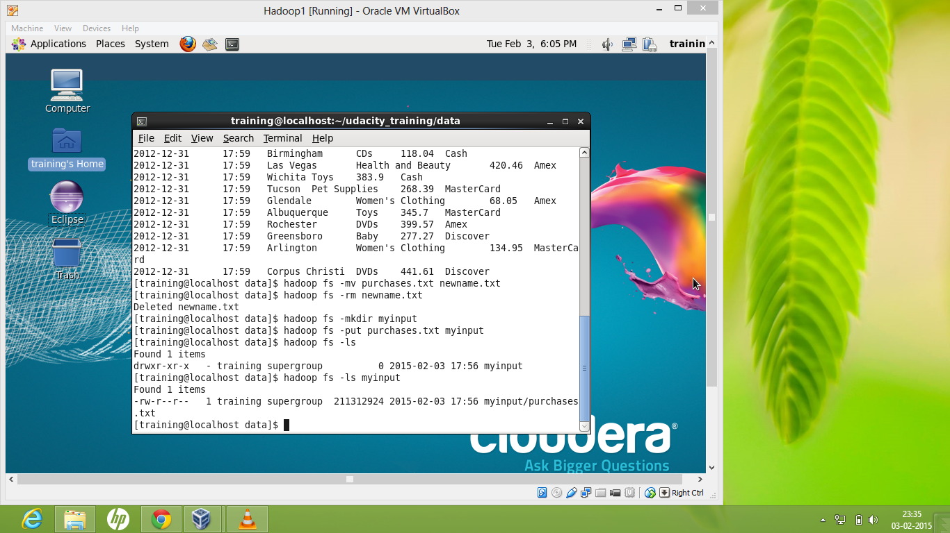

Slide 8
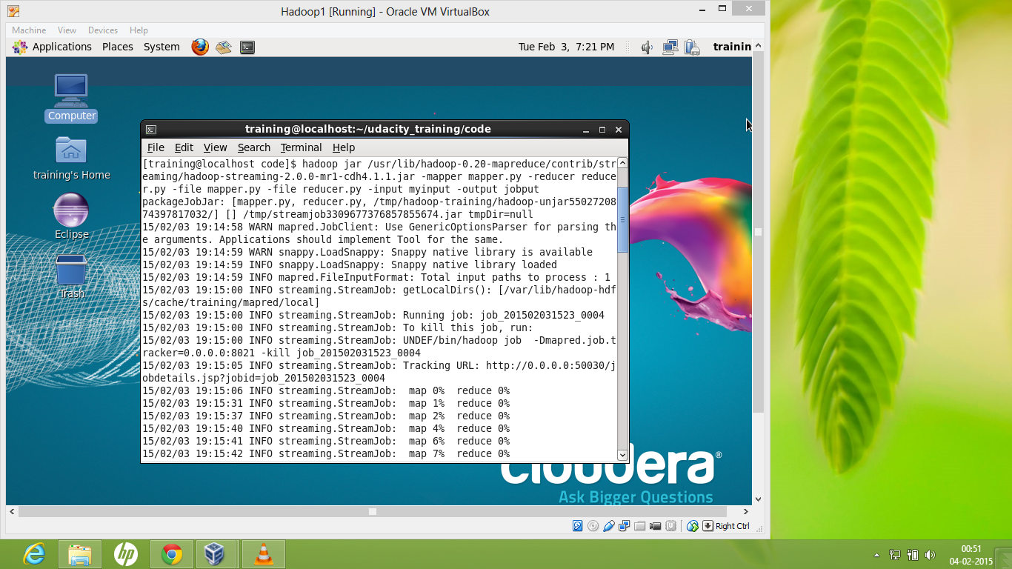

Slide 9
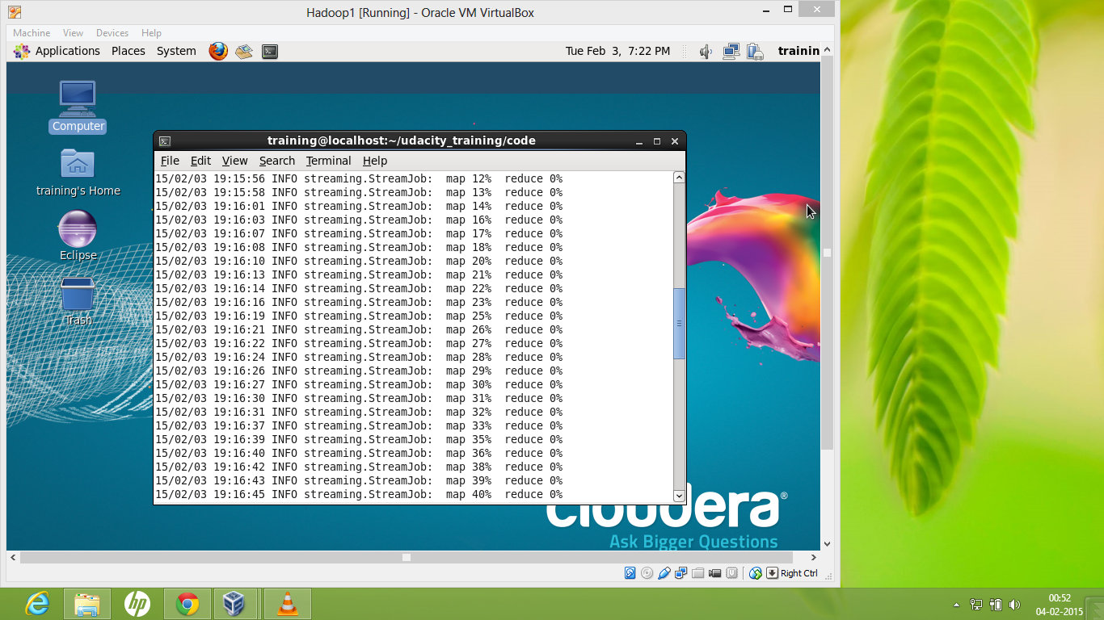

Slide 10
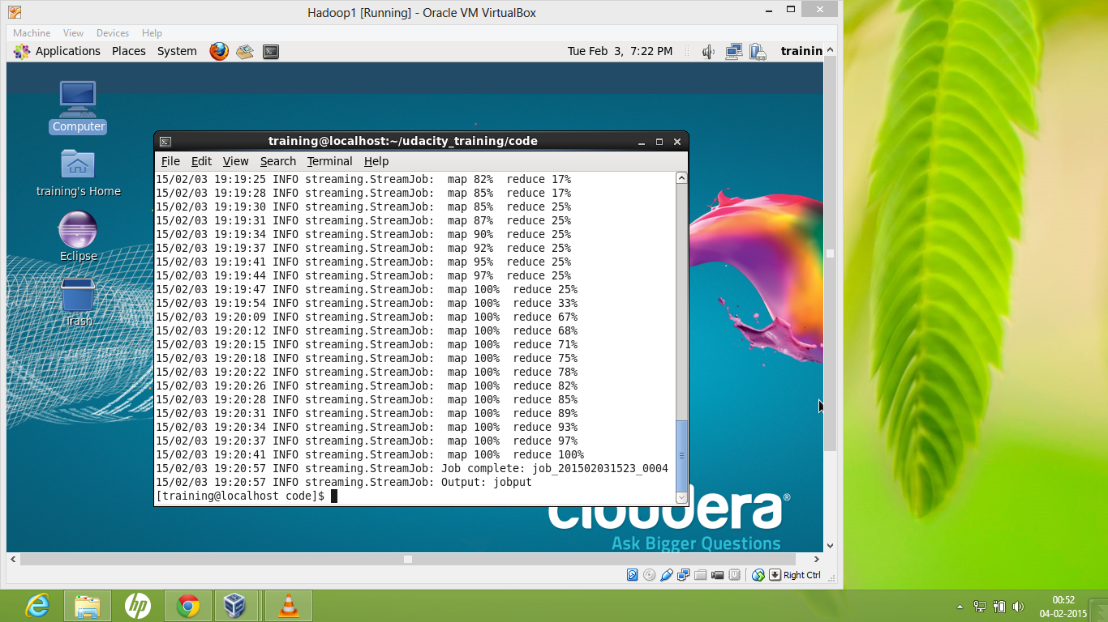

Slide 11
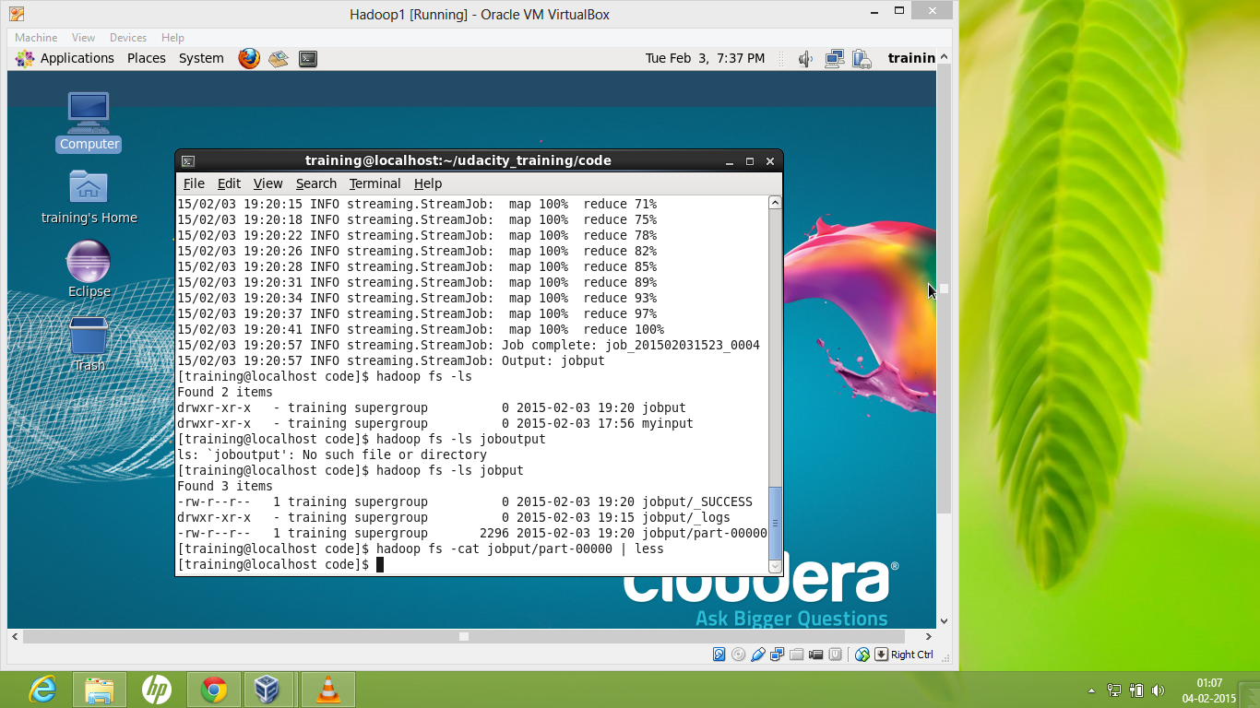

Slide 12
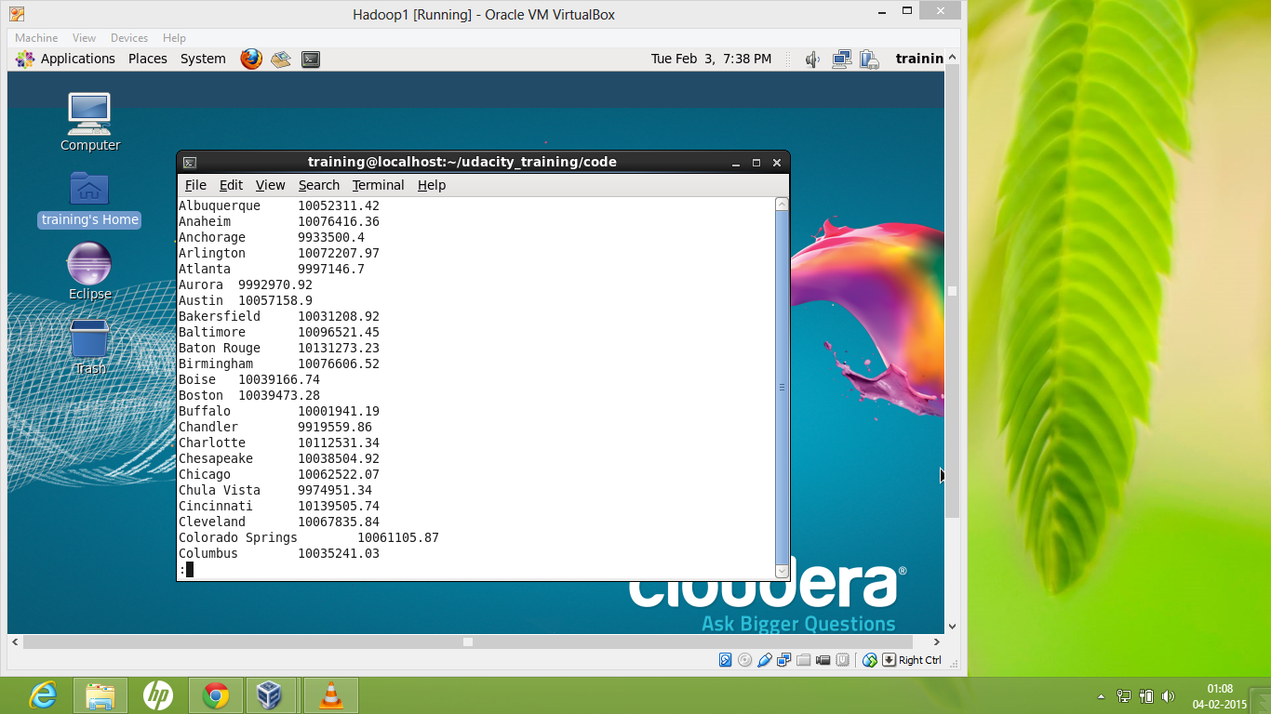

Slide 13


Slide 14
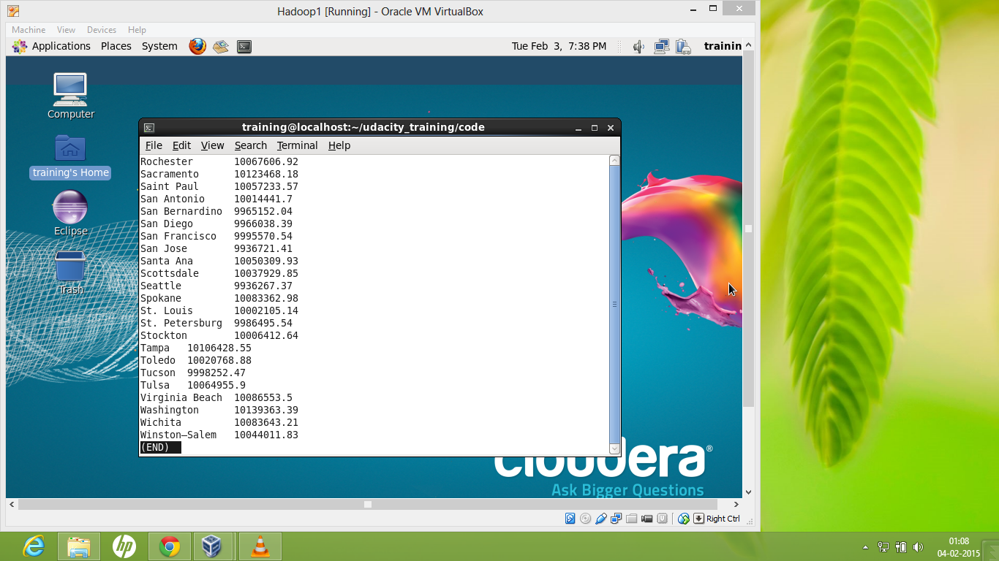

Slide 16
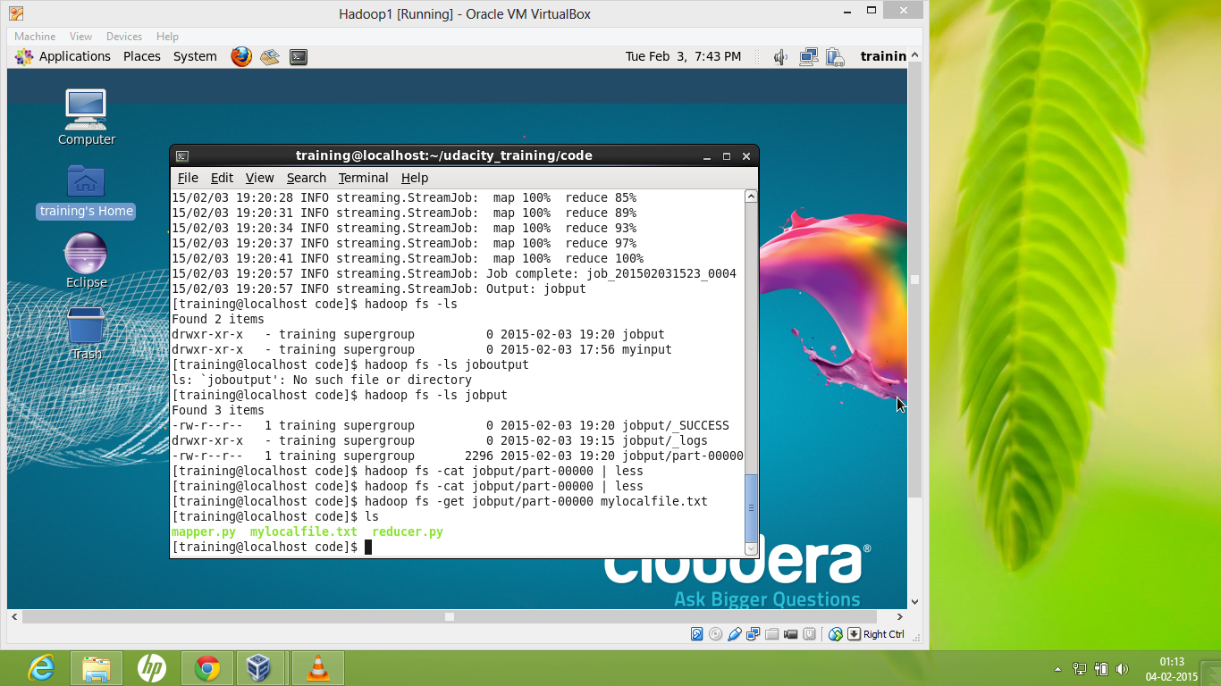

Slide 17
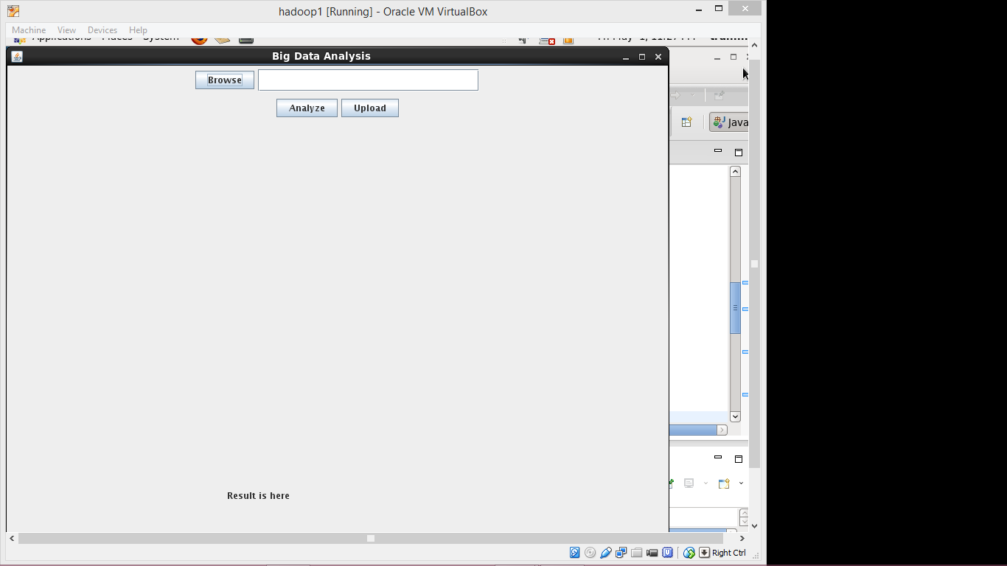

Slide 18
THANKING YOU

